Slide 1

Team D: 삼김이최고

Slide 2
Front-End

Slide 3
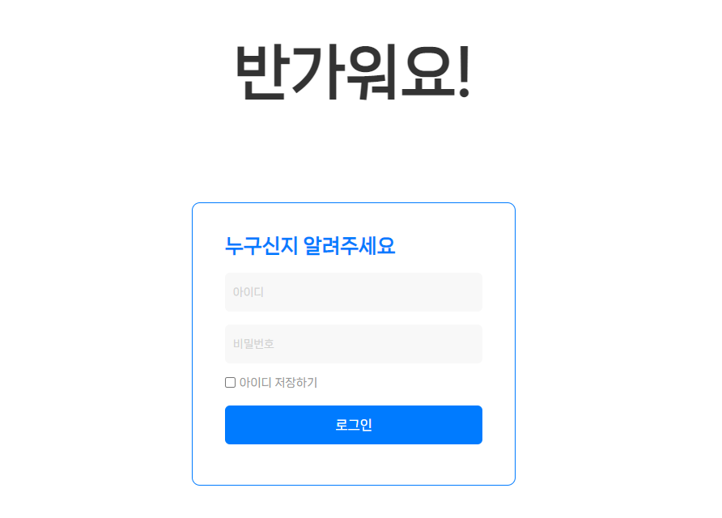
Login Page

Slide 4
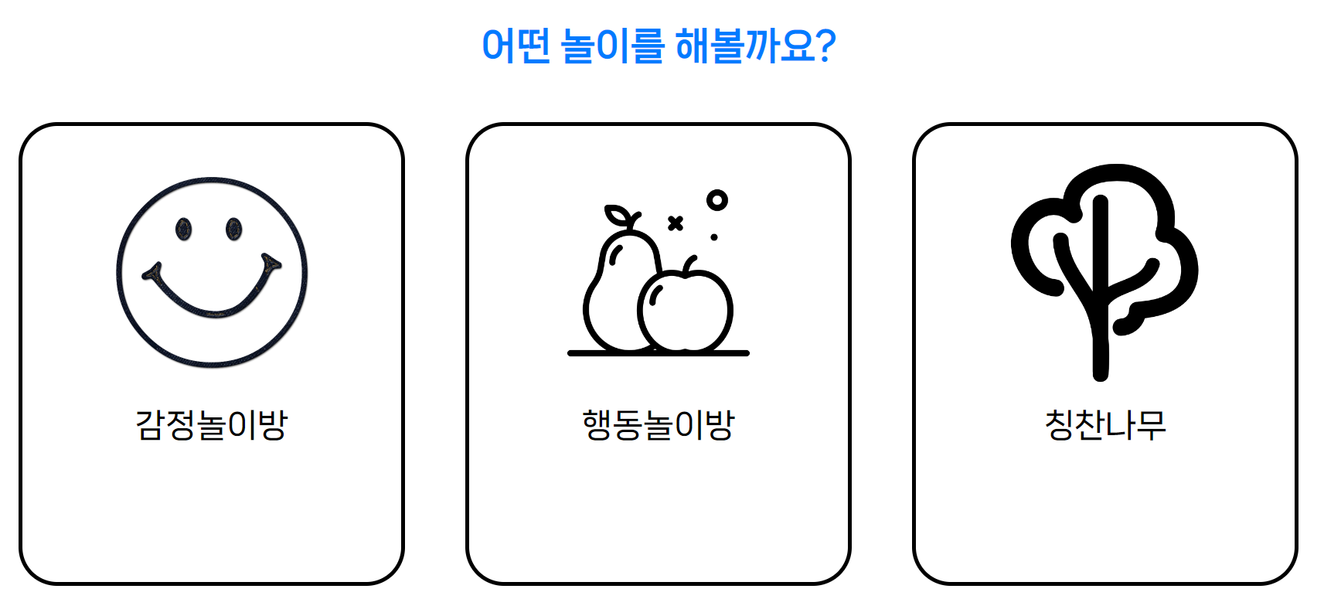
Main Page

Slide 5
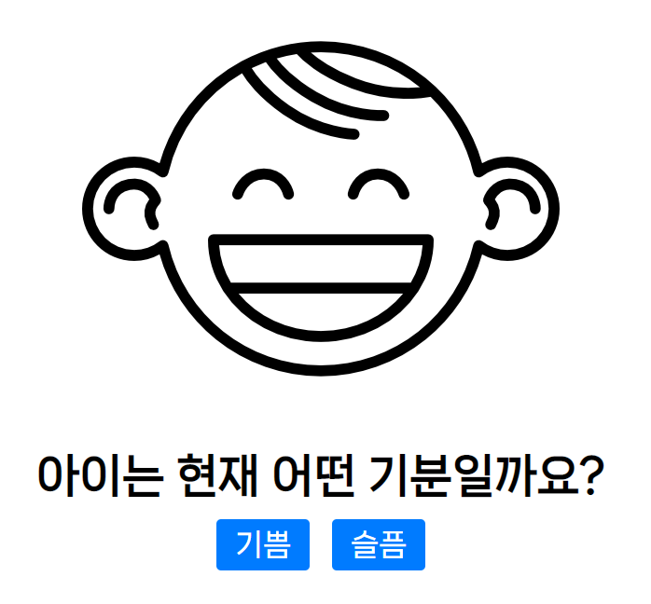
Emotion Page

Slide 6
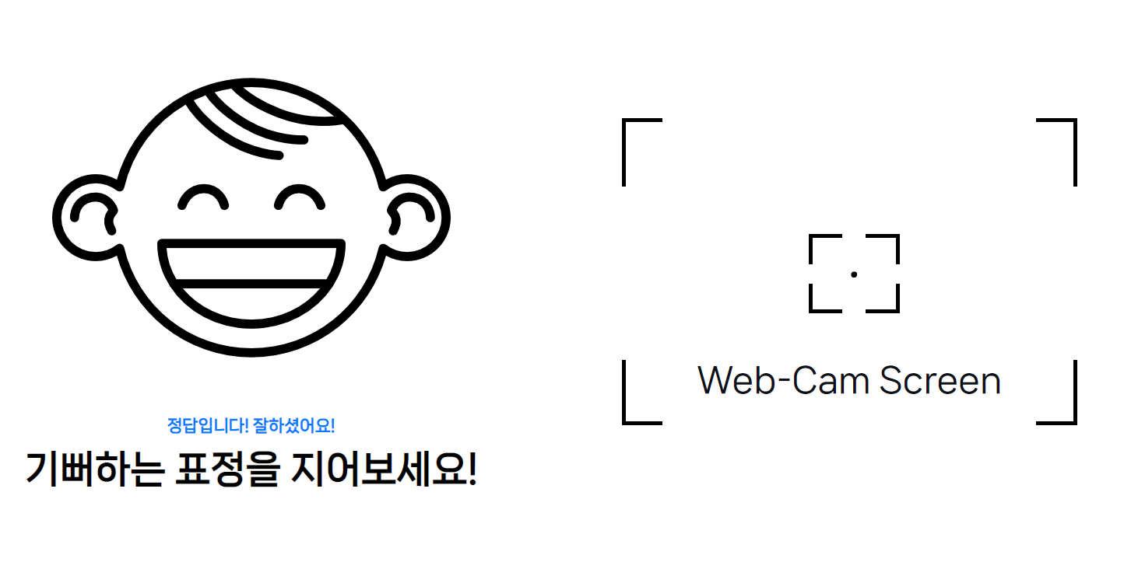
Emotion Page

Slide 7
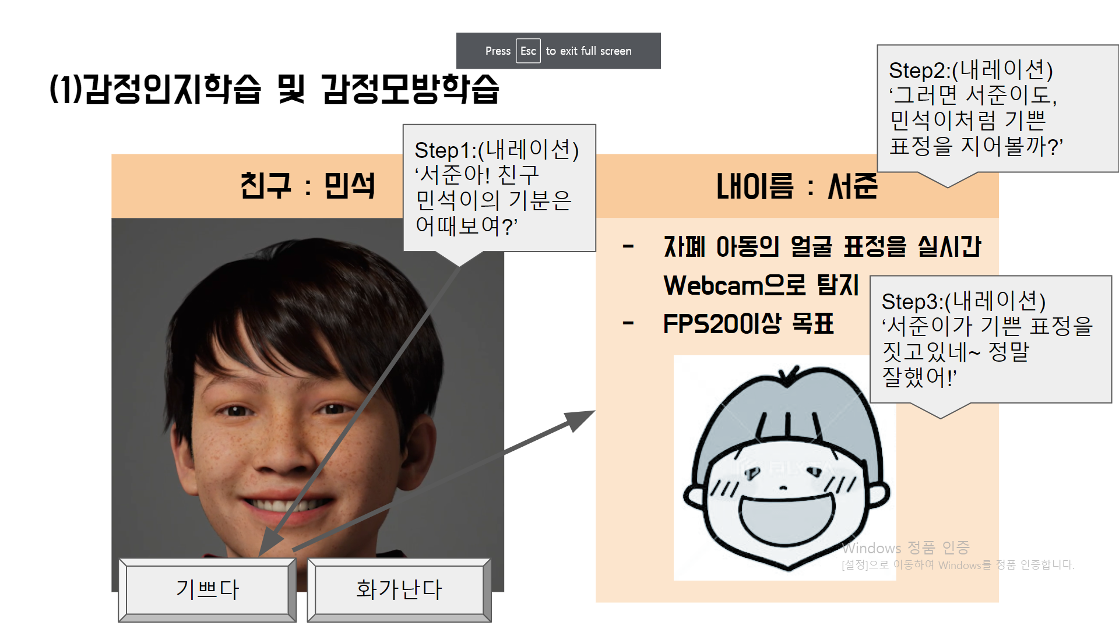
Facial emotion Image

Slide 8
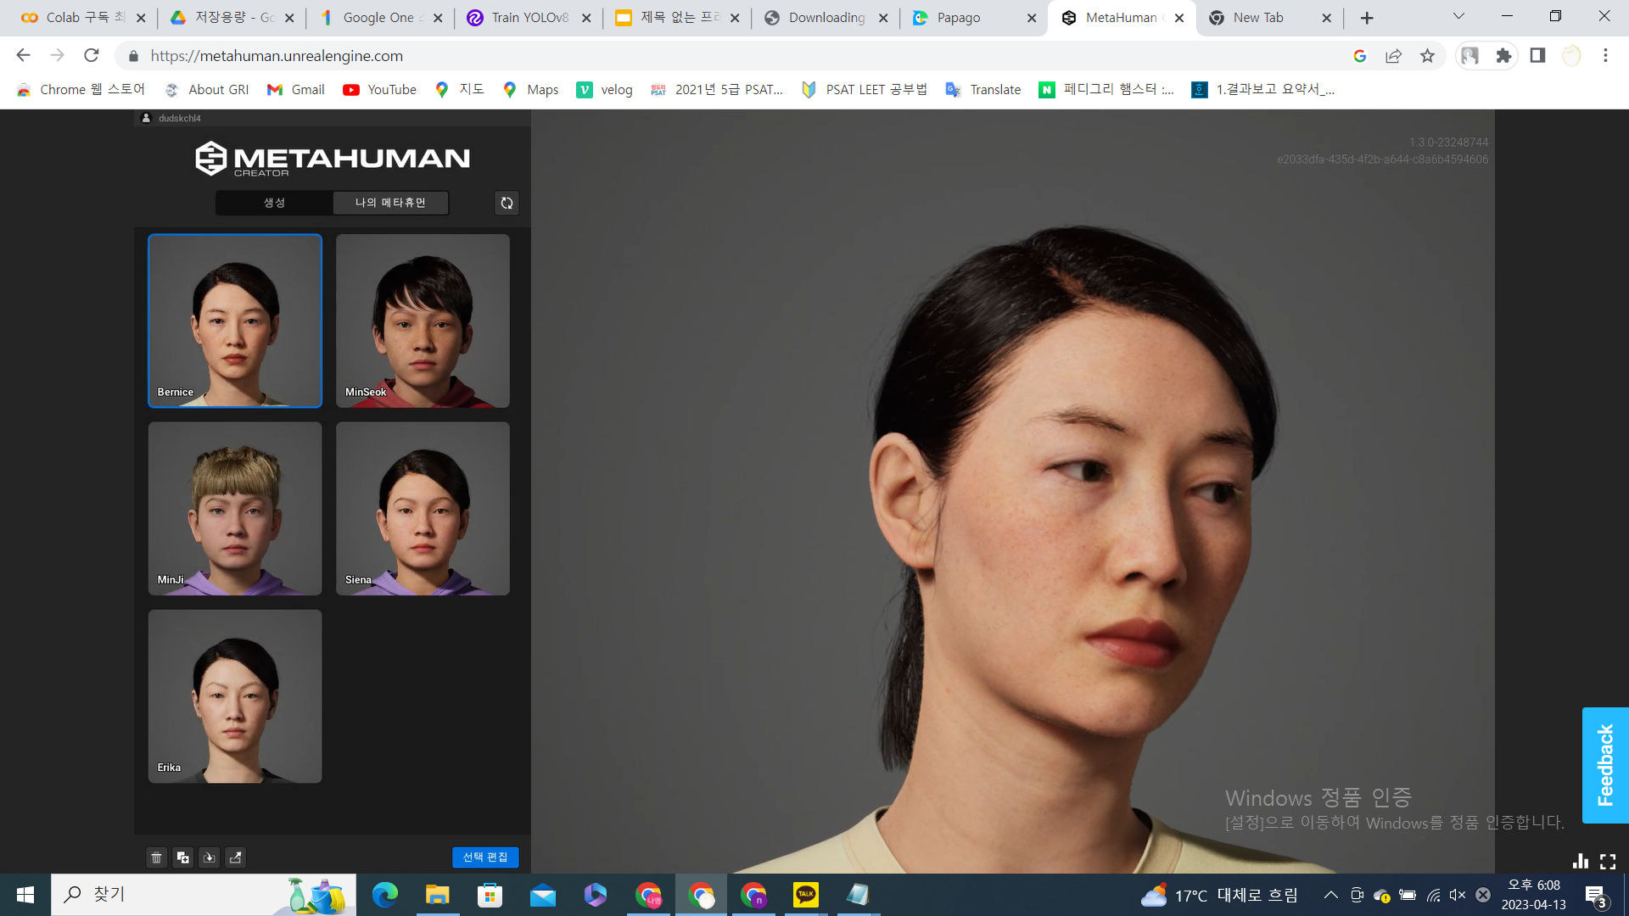
METAHUMAN
언리얼엔진에서 제공하는 meta human creator를 통해 human model을 생성
5명의 model의 5가지 표정 등을 추출(happy, anger, surprise, sad, fear)
초상권 침해 문제를 피할 수 있음.

Slide 9
Emotion Dataset

Slide 10
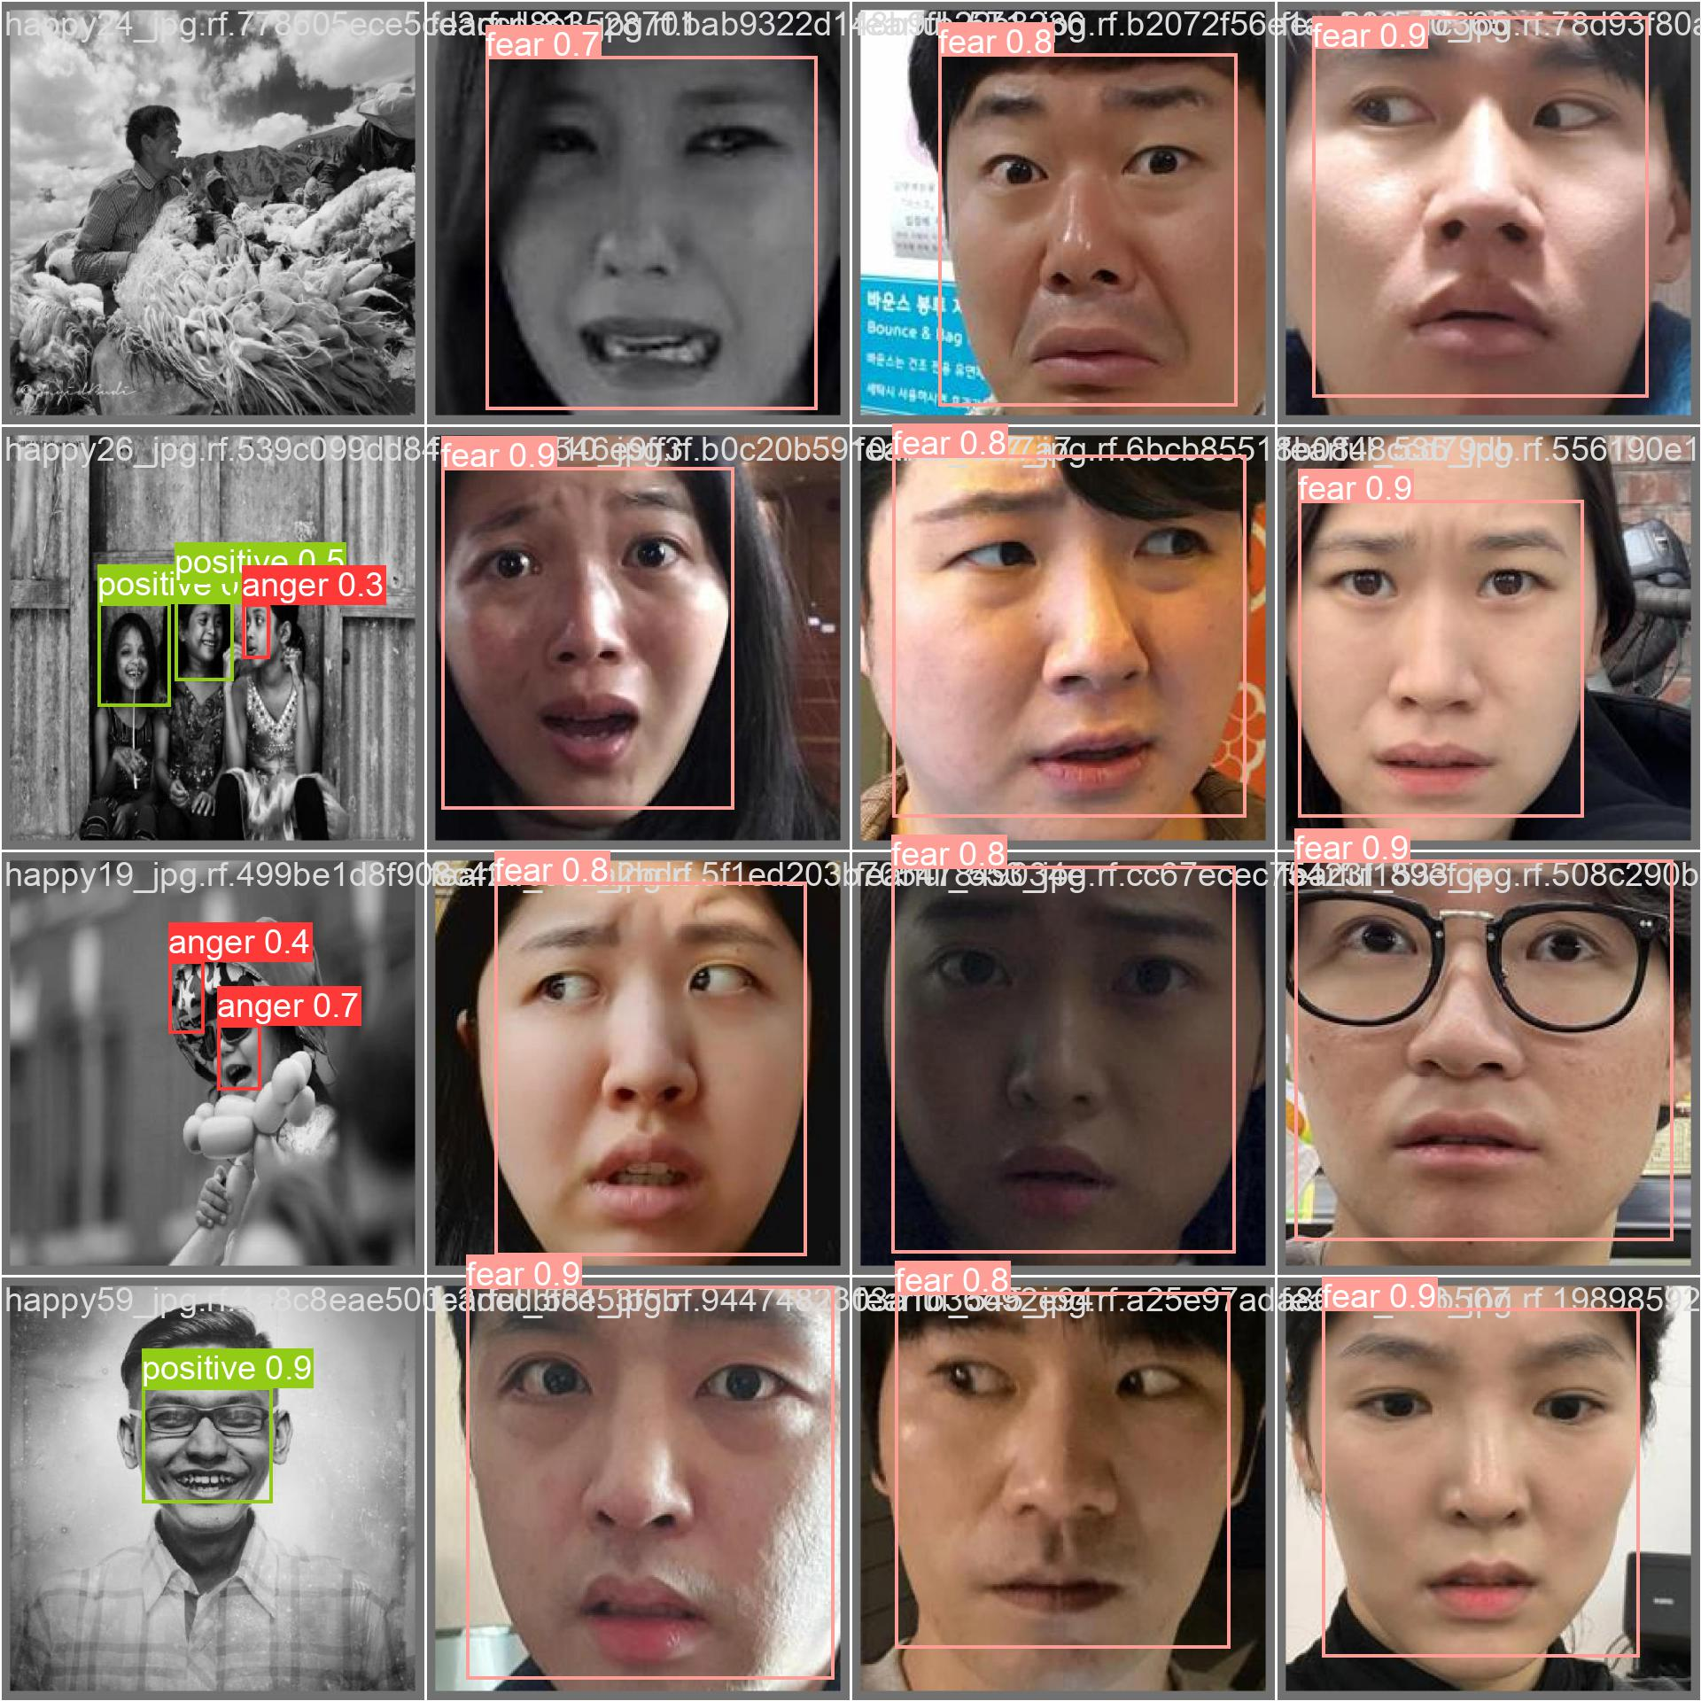
Result - fear, anger, sad: fair

Slide 11
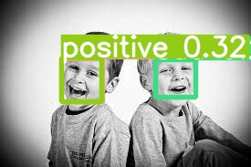
Problem : low recognition of happiness
positive (happiness) 감정의 인식률이 낮음.

Slide 12
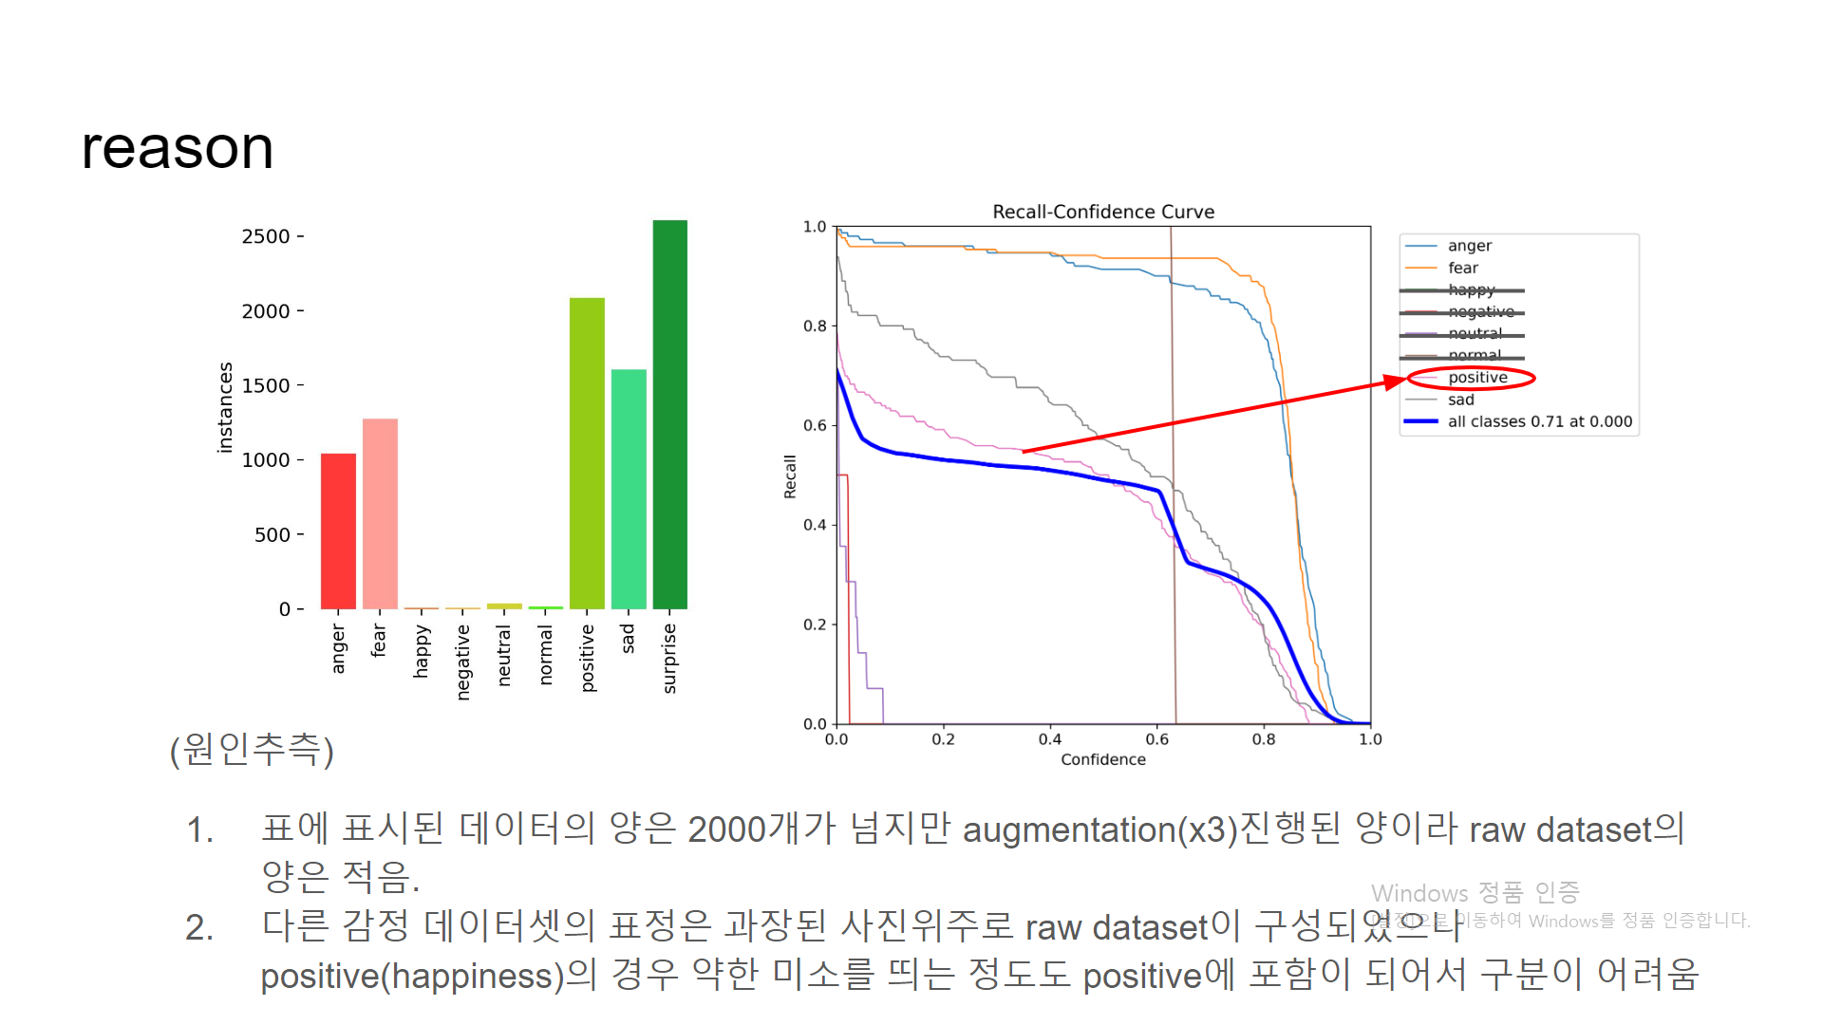
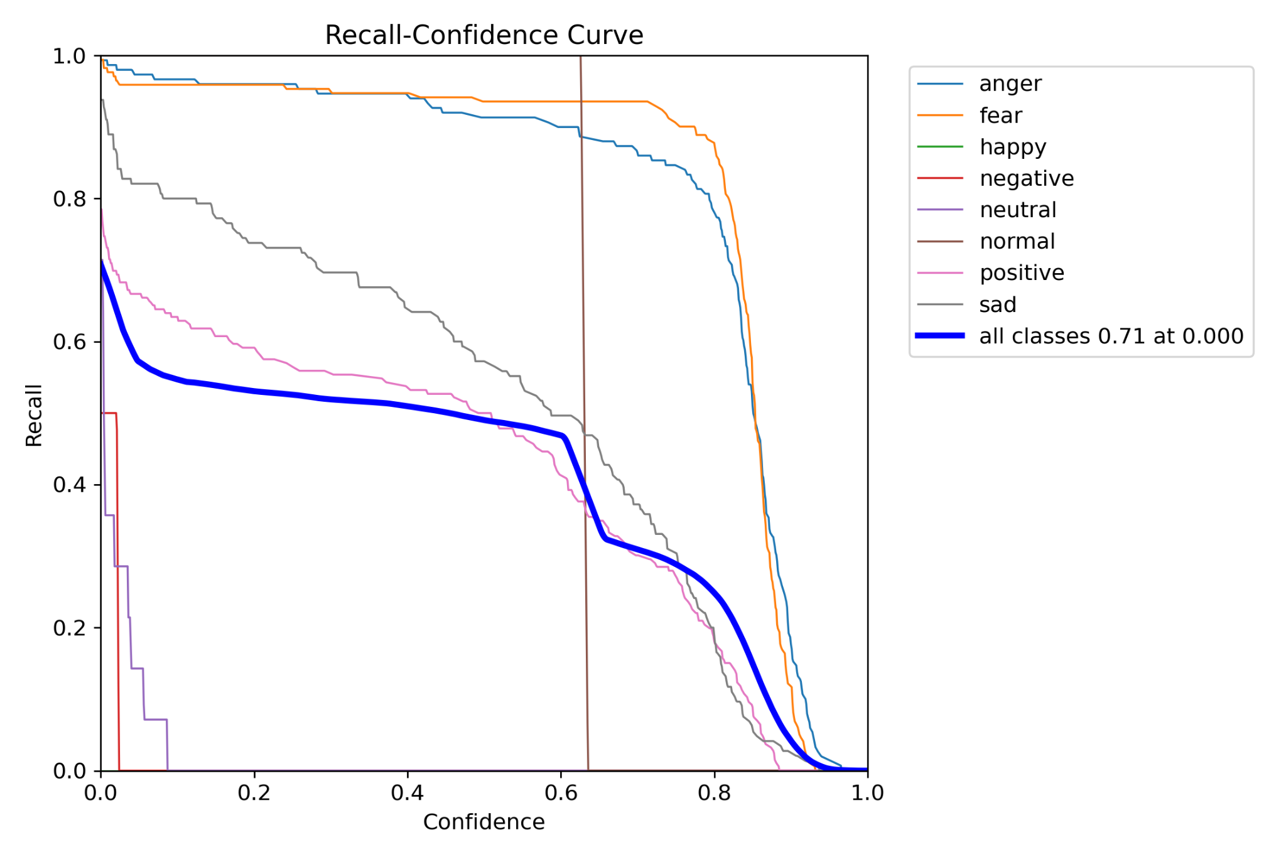
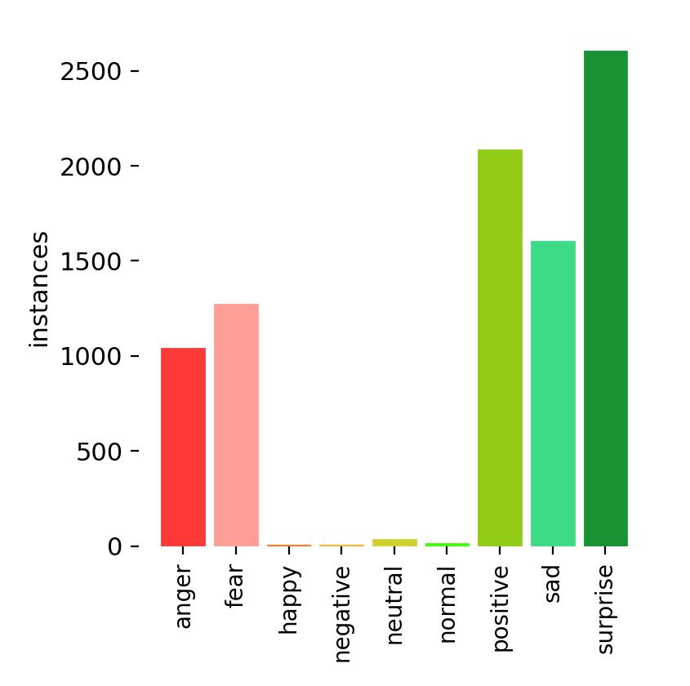
Reason
표에 표시된 데이터의 양은 2000개가 넘지만 augmentation(x3)진행된 양이라 raw dataset의 양은 적음.
다른 감정 데이터셋의 표정은 과장된 사진위주로 raw dataset이 구성되었으나 positive(happiness)의 경우 약한 미소를 띄는 정도도 positive에 포함이 되어서 구분이 어려움

Slide 13
Solution Plan
기존에 yolov8m.pt로 모델링작업 => yolov8x.pt로 작업 변경
positive(happiness) raw dataset 추가작업
무표정이 positive와 구분되도록 neutral dataset 추가

Slide 14
COCO Dataset

Slide 15
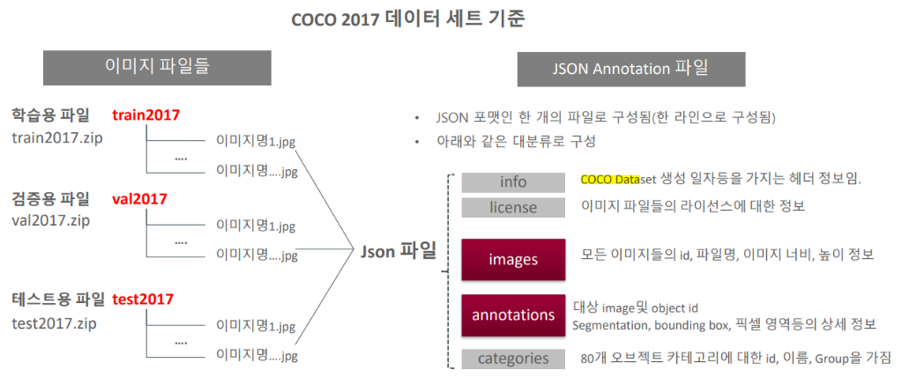
COCO DATASET
Notes:
As we explained in last week, this shows how coco dataset is organized. In coco dataset, there are image files and json files which have imformations about image, like data class or bounding box.
In this week, we tried making our own dataset by making annotations in json file.

Slide 16
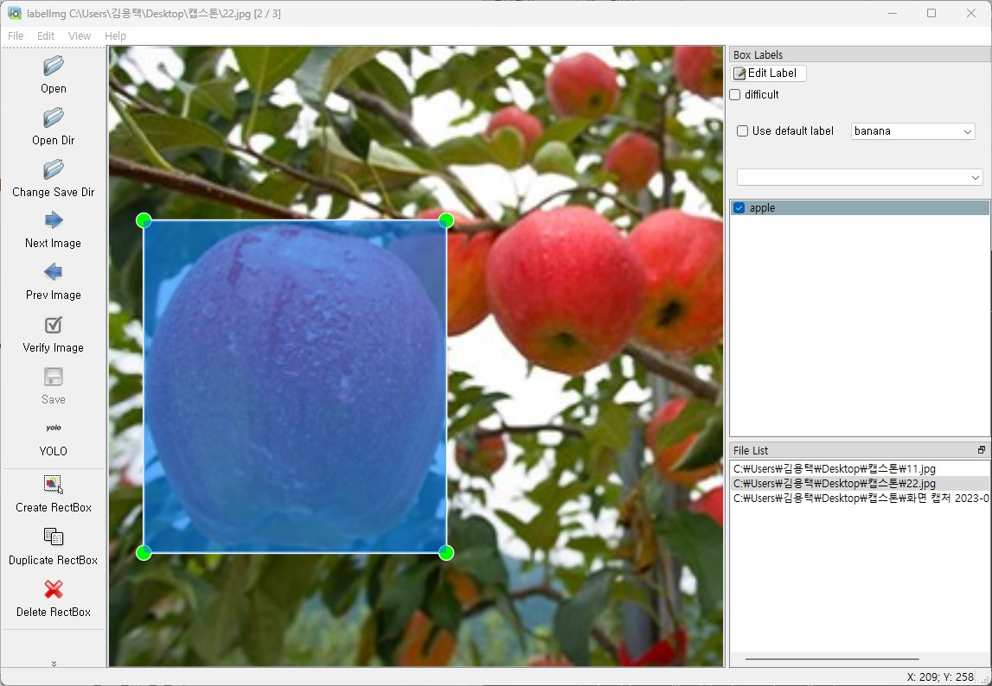
COCO DATASET
How to Add Our Own Dataset
Using LabelImg
program by PyQt in Python
Change DataSet Type
to YOLO
Notes:
This is how we tried. We use program named LabelImg by PyQt in python. In there, we can change image to coco dataset to training Yolo model.

Slide 17
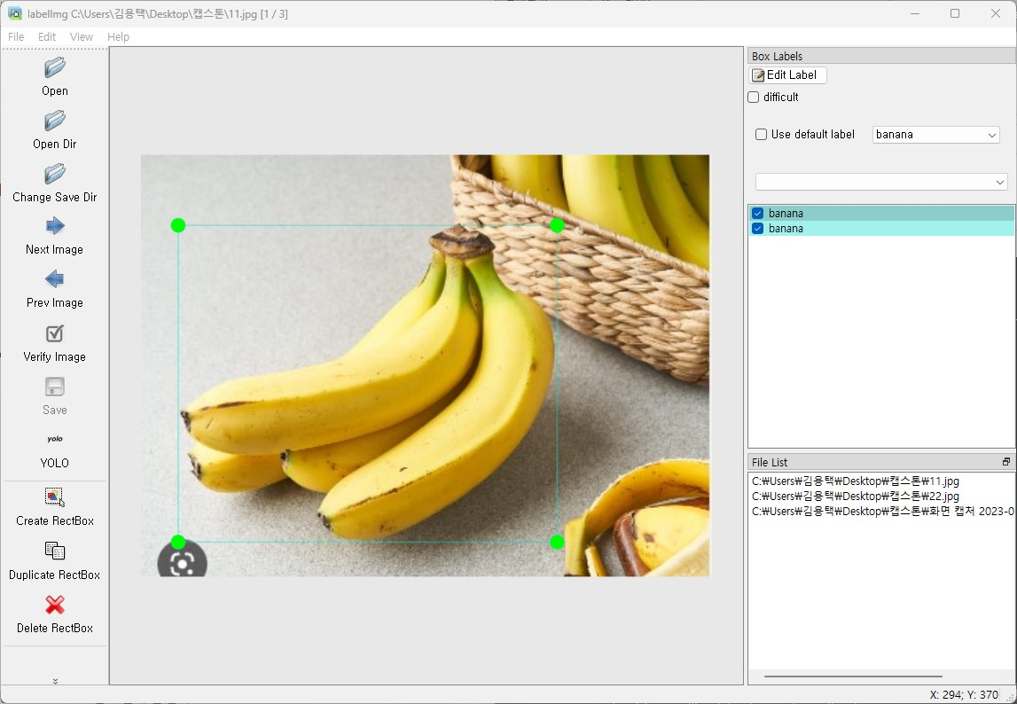
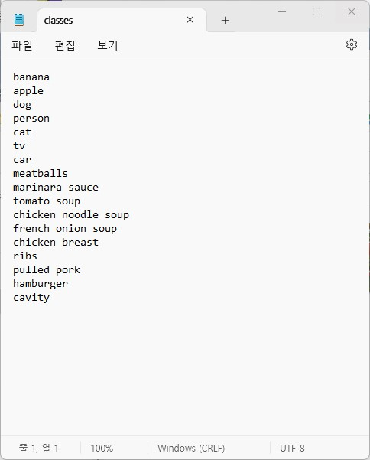
COCO DATASET
Notes:
First, we modified classes file to add our own data set.
And then, import images to LabelImg program.
Then, we can make bounding box and add class of object. Also we can add several bounding box or class of object in one image.

Slide 18
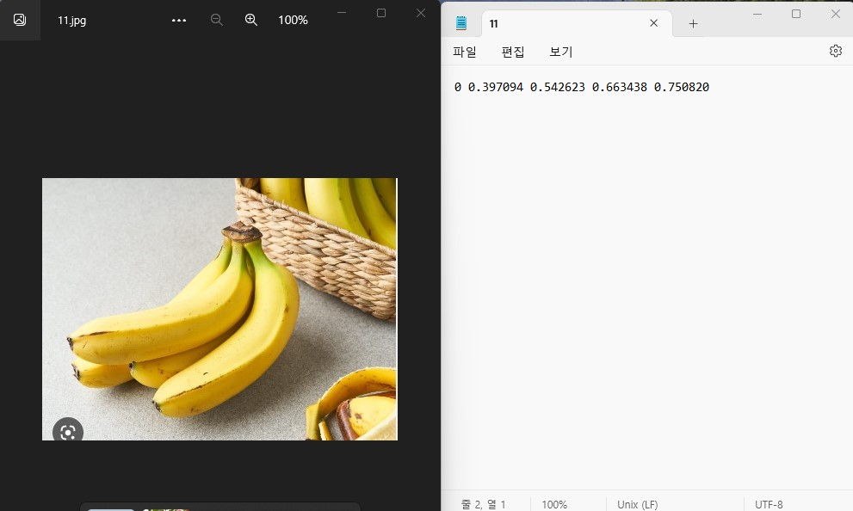
COCO DATASET
YOLO Model
Can Train
By these Image and Annotations File
Notes:
After this process, Annotation file is generated for all images. It include number of class of object, and information about bounding box of object. This files can be used for training YOLO model.
And this data labeling and training will be in progress from next week.

Slide 19
Next Week’s Plan
감정데이터셋 성능 향상
사물데이터셋 과일클래스 추가
webcam 연동
로그인/ 회원가입 구현 프로토타입

